Slide 1
Churn Analysis
June 2024

Slide 2

Churn Analysis
The customer churn analysis can be defined as analytical work carried out on the possibility of a customer leaving a product or service. In its simplest definition, it means that customers are abandoned to choose the company because of competition. The purpose is to identify this situation before leaving the customer's product or service, and then to carry out some preventive actions.
It answers the questions “Are we losing customers?” and “If so Who?” to allow teams to take action. Lower churn rates lead to happier customers, larger margins, and higher profits.

Slide 3
Importance of Churn Analysis
It is particularly important in the calculations of a business in sectors such as insurance, telecommunications or banking, which is a subscription-based income model. According to researchers, winning new customers in today's competitive conditions is up to 10 times costlier than retaining existing customers.
It is an analysis method used in areas such as determining profiles of existing customers, analyzing customer escapes and estimating customer escape.

Slide 4
Technical Definition
The event of churn is usually measured through a probability.
Churn Event
Churn Probability
The loyalty is defined as the opposite to churn and is defined as follows:
Loyalty=1-Churn Probability

Slide 5
Background in Telecom Industry
Telecom companies face major challenge with customer churn, as customers switch to alternate provider due to various reasons like lower cost, multi (combo) service offerings, marketing promotions by competitors, etc.
- In the USA, there are 7 telecom companies that serve customers in all 50 states.
- Identifying these potential customers early on who may voluntarily churn and providing them retention incentives in form of discounts & combo offers will help the organization to retain those customers and reduce revenue loss.

Slide 6

Background in Telecom Industry
- The company can also internally study any possible operational causes and improve its product offerings.
- Proactive actions will prevent the loss of revenue for the company and will improve / retain the market share among the industry peers in terms of the number of active subscribers.

Slide 7
Variables and Churn
• Demographic attributes: contain the primary features of the customer such as sex, age, nationality, place of residence, etc.
• Contract attributes: contain the attributes associated with the customer contract for a particular service such as type of service, date of conclusion of the contract, price of the service etc.
• Customer behavior attributes: describe the customer activities.

Slide 8

Data Cleaning
The presence of noise, unknown or empty values, outliers and invalid values may negatively affect the performance of the machine learning algorithm by using the raw data. The purpose of data cleaning is to reduce the number of inconsistent values, remove noise and incomplete entries and attributes.

Slide 9
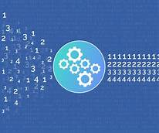
Data Transformation
Data transformation techniques can significantly improve the overall performance of the churn prediction, which we have seen while experimenting with potential transformations.

Slide 10
Techniques Used in Customer Churn Analysis
The primary aim of machine learning is to develop models that can train to develop themselves and by detecting complex patterns and to create models to solve new problems based on historical data.
Artificial Neural Networks (ANN)
Decision Tree
Support Vector Machine (SVM)
Naive Bayes
Logistic Regression
k-Nearest Neighbor (k-NN)
Extreme Gradient Boosting (XGBoost)

Slide 11
Dependent Variable
In order to get a probability of churning, the dependent variable is modelled as binary that takes 1 if the churning occurs and 0 otherwise.
1 if the churns occurs
Y =
0 otherwise

Slide 12
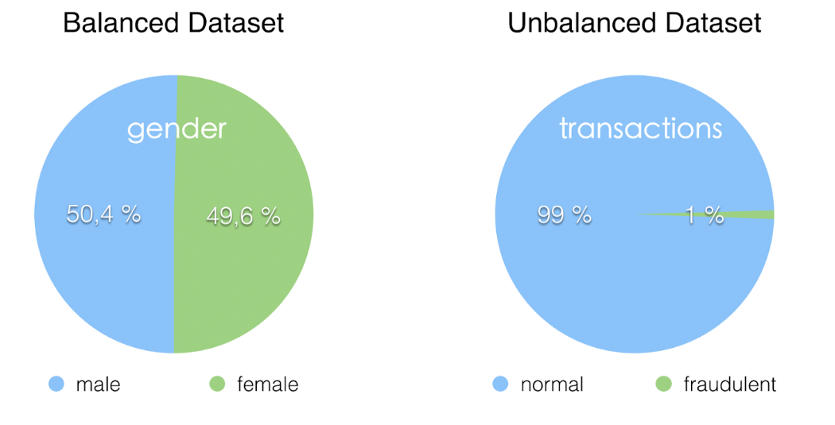
Unbalanced Datasets and Assemble

Slide 13
Assemble
Let is suppose that we have a dataset of 100 observations. In this dataset we have 10 ones and 90 zeros.
………………….........
10 ones
10 zeros
10 ones
10 zeros
10 ones
10 zeros
10 ones
10 zeros
Model 1
Model 2
Model n-1
Model n
The results are averaged

Slide 14
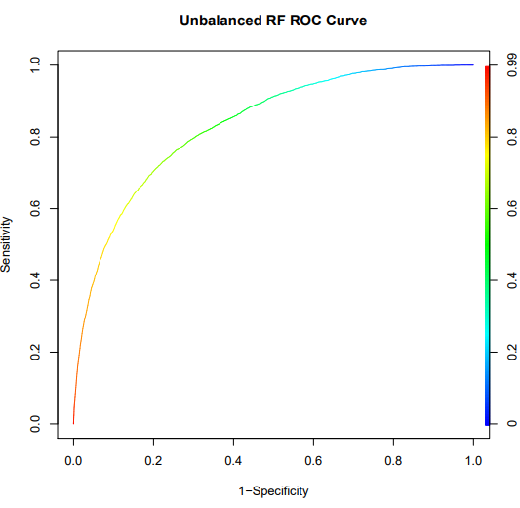



Model Performance
2
3
Model performance is measured by its prediction accuracy in the test period. Accuracy indicates how well the model discriminates between abandonment and non-abandonment events. Usually, accuracy represents the area under the ROC curve.
Area under ROC curve makes sense when the test set is balanced
$$ACC=\frac{{True}_{positive}+{True}_{negative}}{Total}$$
Accuracy
Accuracy
$$BACC=\frac{{RTrue}_{positive}+{RTrue}_{negative}}{2}$$
> 80%
Balanced accuracy
Assembled accuracy
$$ACC_{promedio}=\frac{{True}_{positive}+{True}_{negative}}{Total}$$

Slide 15
Caso de Estudio
Predecir el retiro temprano en una empresa de seguros que ofrece planes de pensiones privado.

Slide 16
Questions?

